Slide 1
Compliance Analytics
Presented by:
Jason Van Wyck

Slide 2
Project Description
Money laundering is used in illegal activities such as human trafficking, drug trafficking, and terrorist funding
AML(Anti-Money Laundering) compliance program
Researched and created a brief presentation on the 5 pillars of an AML program and AML act of 2023
Project Deliverables
Created models for the dataset we used called Alerts Suspicious Activity Report(SAR) to determine the highest accuracy score using Colab
Performed statistical analysis for the transaction dataset to identify the highest mean, max, min, standard deviation, and the percentiles
Tableau was used to analyze trends for the regulatory findings and identify which countries have the most penalties
Using SQL to create a scenario logic that looks at multiple factor to identify if a customer is PEP(Politically Exposed Person) and if the customer is in a high risk country
Kenneth Ross is our project sponsor (Compliance Analytics LLC)

Slide 3
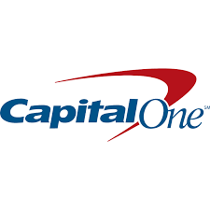

Hypothesis and Business Case
Banks are responsible for guarding against money laundering
Help Fincen (Financial Crimes Enforcement Agency) by filing Suspicious Activity Reports (SARs) that may lead to criminal investigations
Can pay massive fines to US government if they are found responsible for complacency in their AML programs
Capital One was fined almost $400 Million for being negligent in anti-money laundering precautions
Standard Chartered Bank was fined $650 Billion for violations of Sanctions regulations
Paying these can seriously impact a company's image and ability to be profitable in the future
Hypothesis: Money laundering can be tracked and fought by inspecticting suspicious transactions between people, banks and corporations.

Slide 4


Business Benefits
Compliance Analytics may use some of the works for future projects (tracking suspected transactions)
An effective aml compliance program will help prevent suspected activities from entering the financial system
Helping to reduce the risk of fraud and other errors within the business.
Strengthening the relationship between the team and its partners, compliance and commitment by the team could help with transparency within the business.

Slide 5
Data sourcing, completeness, and quality of data
The data sourced is a sample dataset with transactional and customer data.
Data completeness was verified by the project sponsor, and adjusted accordingly
The quality of the data is very useful and we created different columns to use to identify specifics transaction amount, customer type, original account
Some of the metrics used for customer data are; name of customer, status, account number, country and country rating for customer data which shows a risk level of high, not high, or N/A in the dataset for Allied UK.
Transactional data uses metrics of customer type, transaction date, transaction number and other metrics involving user information.

Slide 6

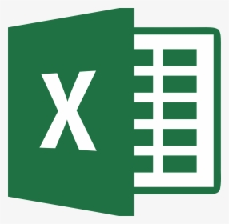
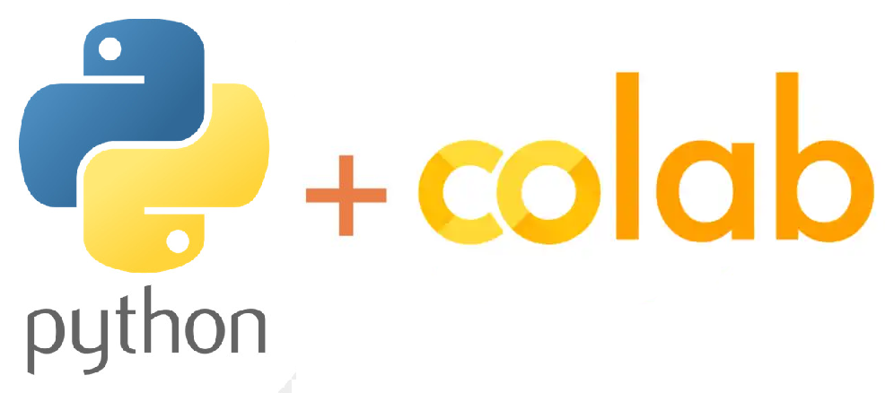
Data models and Analytics Tools
Excel, Python, Tableau, Colab notebook, Oracle and SQL
Performed statistical analysis on transactional dataset to identify different behaviors for customer types
Ran various models to predict suspected behaviors
Modified data to increase the accuracy scores
Used data to pull transactions related to Multifactor alerts

Slide 7
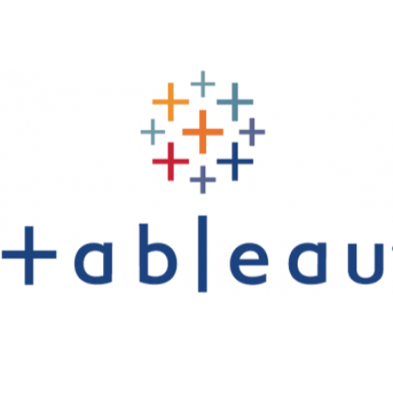
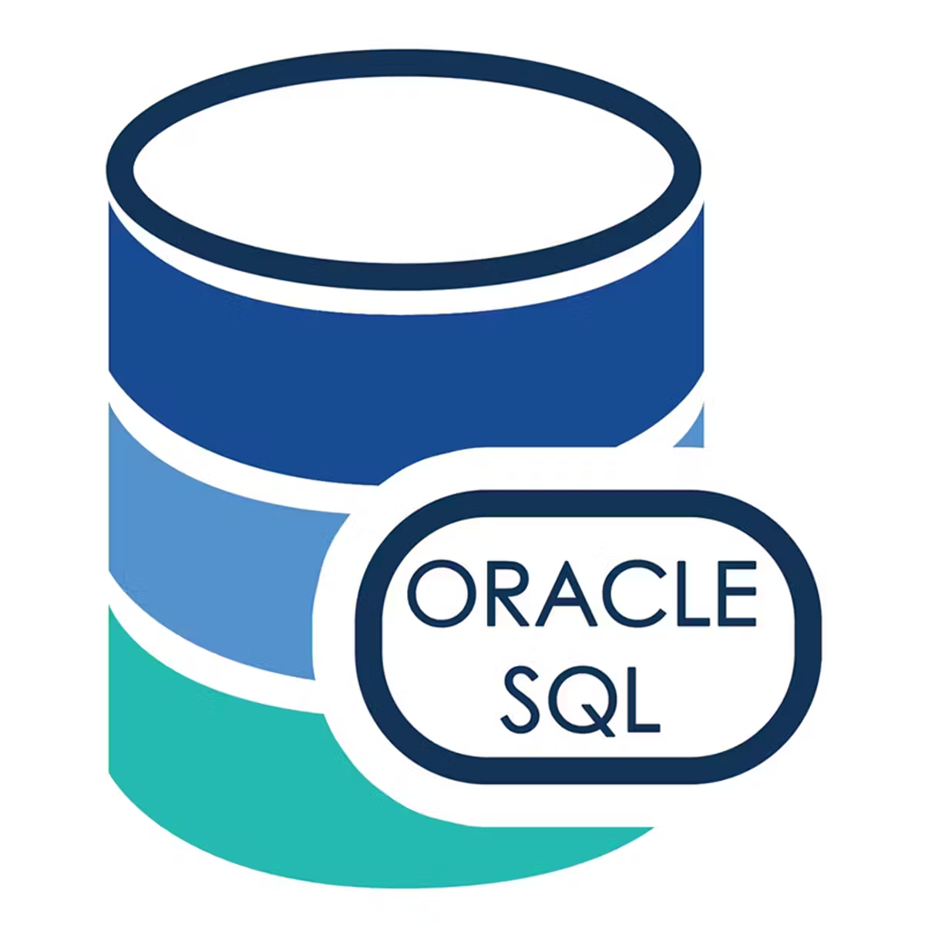
Data models and Analytics Tools
Analyze the customer dataset to identify the transactions that are suspicious
Used Tableau to create visualizations for the regulatory findings
Also used a combination of Oracle and Google Colab to run data involving alerts data, transaction data, and Scenario Alerts data
Combination of all these various tools gave us strong insight into the data and identified the needed information.

Slide 8
Info of Alerts Suspicious Activity Report(SAR) data
Independent
SAR Filed
Dependent
Total Transaction Amount
Prior SAR
High Transaction Amounts
Level 1 or 2 Investigation
High Risk Address
High Risk Counterparty
Customer Risk Rating
# of Transactions
Round Dollar Transactions
Trade related Transactions
Number of Counterparties
Number of Jurisdictions
3,999 records
2 Customer Types: CORP and IND
SAR Filed indicates that a suspicious activity report was filed with FINCEN, determined that an activity must be reported
Dependent variables are related to transactions that were alerted and considered high risk

Slide 9
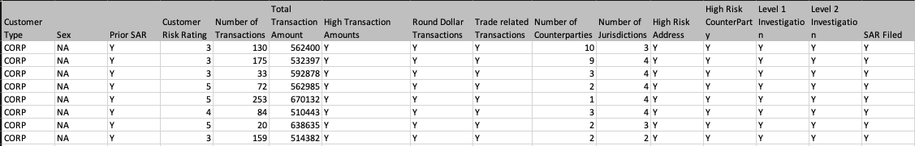
Model Performance
Model | Accuracy | Recall | Precision | ROC AUC
Knn | .9967 | 1 | .9787 | .9985
Logistic Regression | .9700 | .9022 | .9022 | .9915
XGBoost | .9975 | .9821 | 1 | .9911
Keras | .8600 | 1 | .86 | .9500

Slide 10
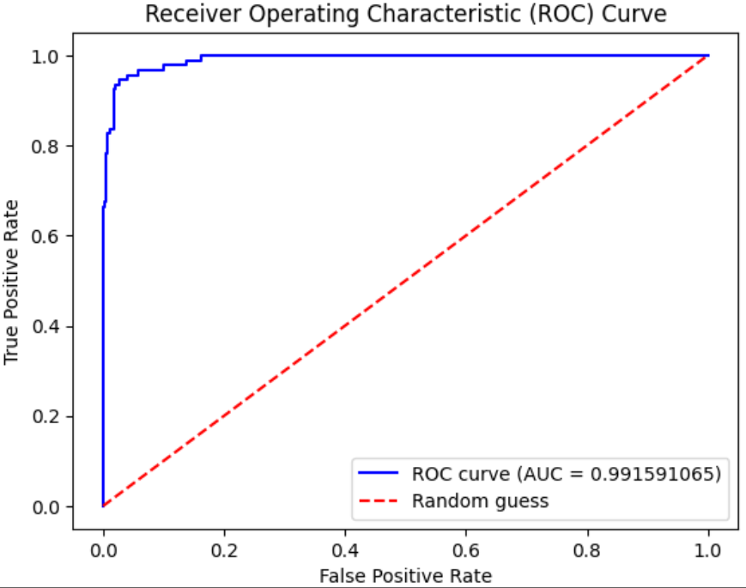
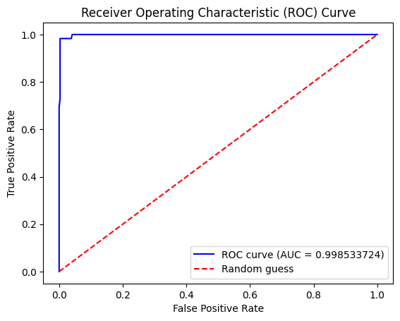
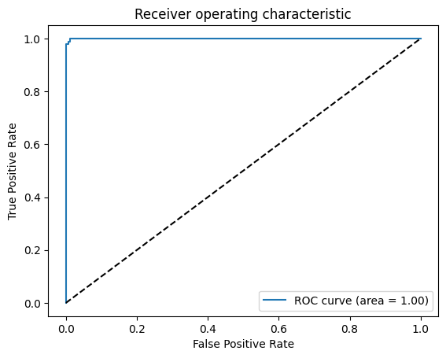
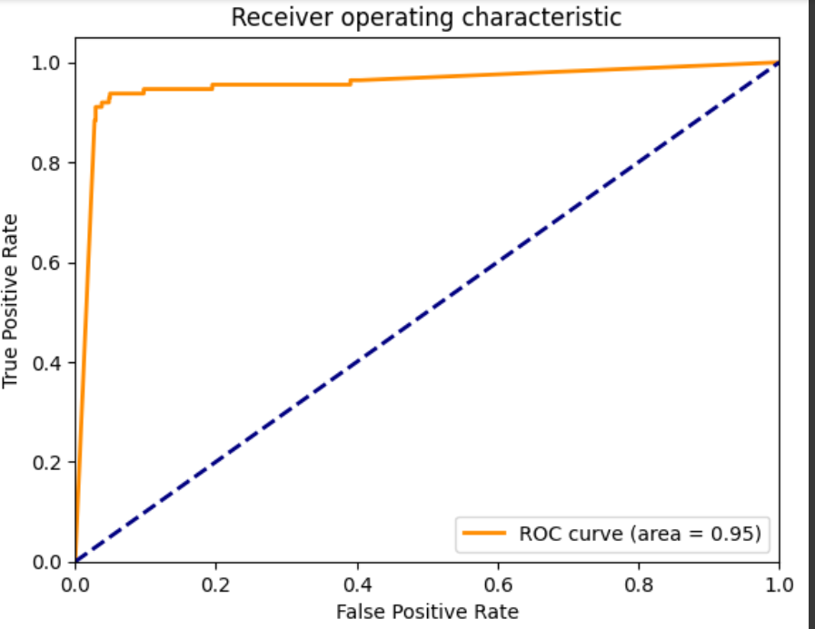
KNN
Logistic Regression
XGBoost
Keras

Slide 11
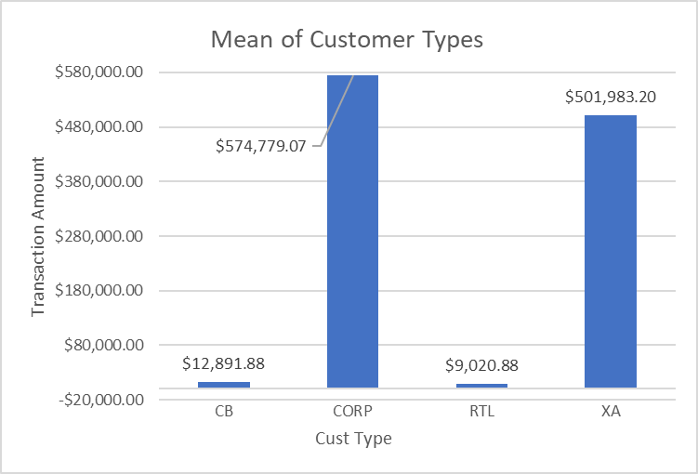
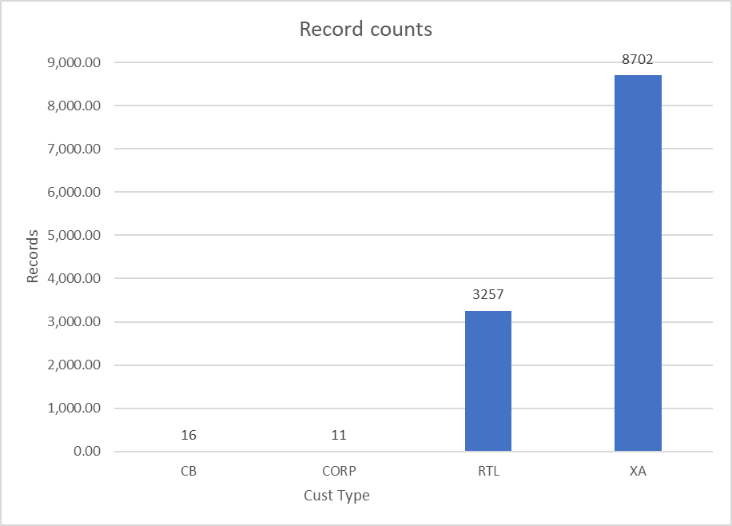
Bar Graphs of Statistical analysis on Customer Types
4 important banks:
CB - Correspondent Bank that provides services to another country. Most likely to be used by domestic banks
CORP - Corporate Customer Bank that provides services to companies(public or private)
RTL - Retail Bank that provides services to individual consumers rather than businesses. Also known as consumer banking or personal banking
XA - External Account which means that the account holder is external to the bank and we rely on the bank to perform adequate AML monitoring for the customers’ transactions.
Notes:
Standard deviation is a mathematical tool to help us assess how far the values are spread above and below the mean. A high standard deviation shows that the data is widely spread (less reliable) and a low standard deviation shows that the data are clustered closely around the mean (more reliable).

Slide 12
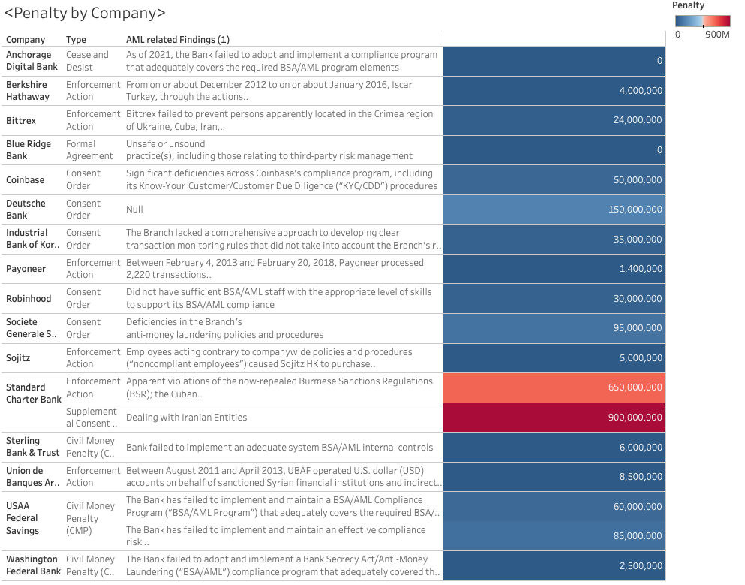

Slide 13
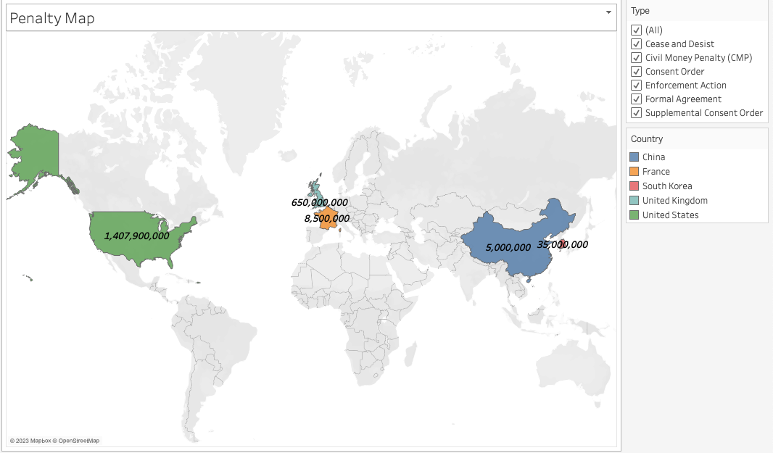
Sample Regulatory Findings 2020-2022

Slide 14
Research and challenges(Conclusion)
Google drive is easily accessible and sources are provided for us
Working on the models and modifying the Alerts SAR dataset
Some difficulties had were with small computing errors, for example with the data result we would get spacing errors for /n, some issues involving which datasets to combine and small technical issues with writing the lines of coding.
With proper documentation of transactions and customer profiles, data analytics can be monumental in keeping banks from paying large government settlements due to being negligent in fighting money laundering.

Slide 15
Research Methodology
“Financial Crime Trends to Watch in 2023.” Financial IT, https://financialit.net/news/security/financial-crime-trends-watch-2023.
“The Five Pillars of an AML Compliance Program.” AML RightSource, https://www.amlrightsource.com/news/posts/the-five-pillars-of-an-aml-compliance-program.
Thompson, William. “5 Financial Crime Trends to Watch in 2023.” ComplyAdvantage, 6 Jan. 2023, https://complyadvantage.com/insights/5-financial-crime-trends-to-watch-in-2023/.
Cunha, Oscar Canario da. “AML Transaction Monitoring & Detection Scenarios.” Pideeco, Pideeco, 4 Nov. 2021, https://pideeco.be/articles/aml-transaction-monitoring-detection-scenarios/.
Johnson, Glenn. “What Are the 3 Stages of Money Laundering?” Alessa, 24 Jan. 2023, https://alessa.com/blog/3-stages-of-money-laundering/.
Tanya Parkhi, et al. “AML Compliance Program: 5 Pillars of Success Revealed.” Regtechtimes, 15 Sept. 2022, https://regtechtimes.com/5-pillars-of-successful-aml-compliance-program/.
“Key Components of US Anti-Money Laundering Law // Cooley // Global Law Firm.” // Cooley // Global Law Firm, https://www.cooley.com/news/insight/2022/2022-12-31-key-components-of-us-anti-money-laundering-law.

